Slide 1

Introduction to Cyber Security
Ritesh Dhanare
Assistant Professor
Information technology Department

Slide 2
Table of Contents
Components of an Information System
Security System development life cycle

Slide 3
Components of an Information System
Software
Hardware
Data
People
Procedures
Networks

Slide 4
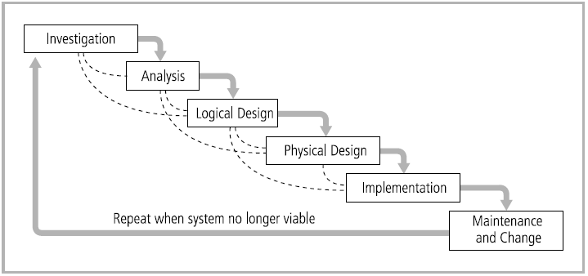
Security System development life cycle

Slide 5
Security System development life cycle
Investigation
Analysis
Logical Design
Physical Design
Implementation
Maintenance and Change

Slide 6
Investigation/Analysis Phases
Security categorization
Preliminary risk assessment
Notes:
Security categorization—defines three levels (i.e., low, moderate, or high) of potential impact on organizations or individuals should there be a breach of security (a loss of confidentiality, integrity, or availability). Security categorization standards assist organizations in making the appropriate selection of security controls for their information systems.
Preliminary risk assessment—results in an initial description of the basic security needs of the system. A preliminary risk assessment should define the threat environment in which the system will operate.

Slide 7
Logical/Physical Design Phases
Risk assessment
Security functional requirements analysis
Security assurance requirements analysis
Cost considerations and reporting
Security planning
Security control development
Developmental security test and evaluation
Other planning components
Notes:
Risk assessment—analysis that identifies the protection requirements for the system through a formal risk assessment process. This analysis builds on the initial risk assessment performed during the Initiation phase, but will be more in-depth and specific.
Security functional requirements analysis—analysis of requirements that may include the following components: (1) system security environment (i.e., enterprise information security policy and enterprise security architecture) and (2) security functional requirements
Security assurance requirements analysis—analysis of requirements that address the developmental activities required and assurance evidence needed to produce the desired level of confidence that the information security will work correctly and effectively. The analysis, based on legal and functional security requirements, will be used as the basis for determining how much and what kinds of assurance are required.
Cost considerations and reporting—determines how much of the development cost can be attributed to information security over the life cycle of the system. These costs include hardware, software, personnel, and training.
Security planning—ensures that agreed upon security controls, planned or in place, are fully documented. The security plan also provides a complete characterization or description of the information system as well as attachments or references to key documents supporting the agency’s information security program (e.g., configuration management plan, contingency plan, incident response plan, security awareness and training plan, rules of behavior, risk assessment, security test and evaluation results, system interconnection agreements, security authorizations/ accreditations, and plan of action and milestones).
Security control development—ensures that security controls described in the respective security plans are designed, developed, and implemented. For information systems currently in operation, the security plans for those systems may call for the development of additional security controls to supplement the controls already in place or the modification of selected controls that are deemed to be less than effective.
Developmental security test and evaluation—ensures that security controls developed for a new information system are working properly and are effective. Some types of security controls (primarily those controls of a non-technical nature) cannot be tested and evaluated until the information system is deployed—these controls are typically management and operational controls.
Other planning components—ensures that all necessary components of the development process are considered when incorporating security into the life cycle. These components include selection of the appropriate contract type, participation by all necessary functional groups within an organization, participation by the certifier and accreditor, and development and execution of necessary contracting plans and processes.

Slide 8
Implementation Phase
Inspection and acceptance
System integration
Security certification
Security accreditation
Notes:
Inspection and acceptance—ensures that the organization validates and verifies
that the functionality described in the specification is included in the deliverables.
System integration—ensures that the system is integrated at the operational site
where the information system is to be deployed for operation. Security control
settings and switches are enabled in accordance with vendor instructions and
available security implementation guidance.
Security certification—ensures that the controls are effectively implemented
through established verification techniques and procedures and gives organization
officials confidence that the appropriate safeguards and countermeasures are
in place to protect the organization’s information system. Security certification
also uncovers and describes the known vulnerabilities in the information system.
Security accreditation—provides the necessary security authorization of an information
system to process, store, or transmit information that is required. This
authorization is granted by a senior organization official and is based on the
verified effectiveness of security controls to some agreed upon level of assurance
and an identified residual risk to agency assets or operations.

Slide 9
Maintenance and Change Phase
Configuration management and control
Continuous monitoring
Information preservation
Media sanitization
Hardware and software disposal
Notes:
Configuration management and control—ensures adequate consideration of
the potential security impacts due to specific changes to an information system
or its surrounding environment. Configuration management and configuration
control procedures are critical to establishing an initial baseline of hardware,
software, and firmware components for the information system and subsequently
controlling and maintaining an accurate inventory of any changes to the
system.
Continuous monitoring—ensures that controls continue to be effective in their
application through periodic testing and evaluation. Security control monitoring
(i.e., verifying the continued effectiveness of those controls over time) and
reporting the security status of the information system to appropriate agency
officials is an essential activity of a comprehensive information security program.
Information preservation—ensures that information is retained, as necessary, to
conform to current legal requirements and to accommodate future technology
changes that may render the retrieval method obsolete.
Media sanitization—ensures that data is deleted, erased, and written over as
necessary.
Hardware and software disposal—ensures that hardware and software is disposed
of as directed by the information system security officer.

Slide 10
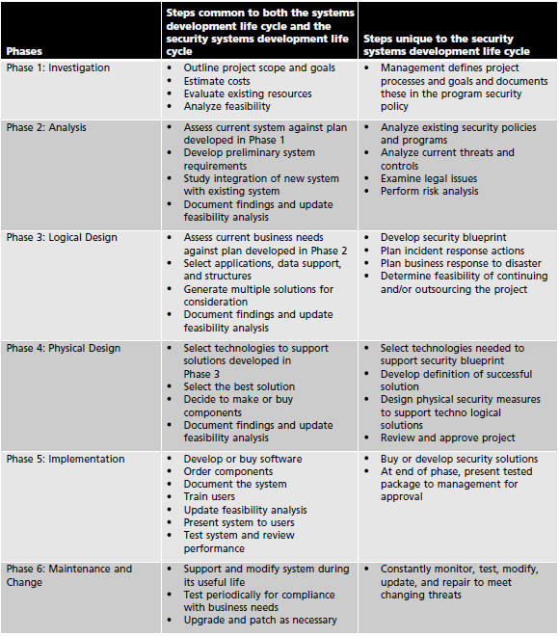
zz

